Slide 1
Web Server Administration
Chapter 19

Slide 2
Objectives
1
2
Web Server Hosting Options
Domain and Name Server Administration
3
4
Linux and Apache Configuration
Apache Request/Response
5
Web Monitoring and Analytics

Slide 3
Web Server Hosting Options
Section 1 of 5

Slide 4
Hosting
Development vs Production
Since you have been working with PHP, you have already worked with some sort of web server.
However, most server tools that simplify matters for development purposes (like WAMP) gloss over the nitty-gritty details of an Apache server.
In a real-world scenario, you must be aware of advanced configuration options, ideas, and tools that ensure your server is deployed and maintained according to established best practices.

Slide 5
Types of Hosting
3 categories
The three broad categories of web hosting are:
Shared Hosting
Collocated Hosting
Dedicated Hosting

Slide 6
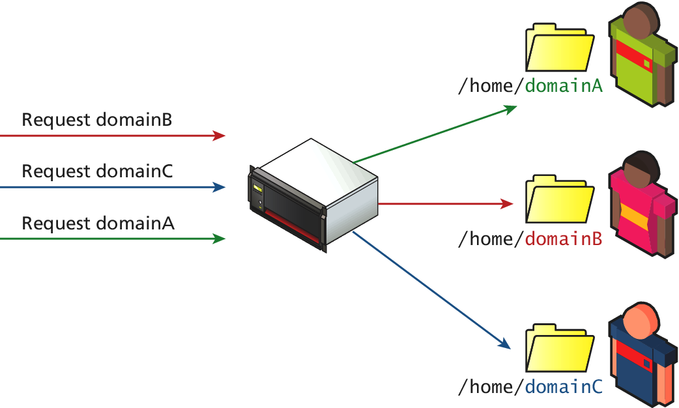
Shared Hosting
Cost effective Hosting
Shared hosting is renting space for your site on a server that will host many sites on the same machine

Slide 7
Shared Hosting
Sharing is ok
Shared hosting is normally the least expensive, least functional, and most common type of hosting solution, especially for small websites.
This class of hosting is divided into two categories:
simple shared hosting and
virtualized shared hosting.

Slide 8
Simple Shared Hosting
The Cheapest
Simple shared hosting is a hosting environment in which clients receive access to a folder on a web server, but cannot increase their privileges to configure any part of the operating system, web server, or database.
The disadvantages of simple shared hosting are many. Lack of control, poor performance, and security threats make shared hosting a bad idea for a serious website.

Slide 9
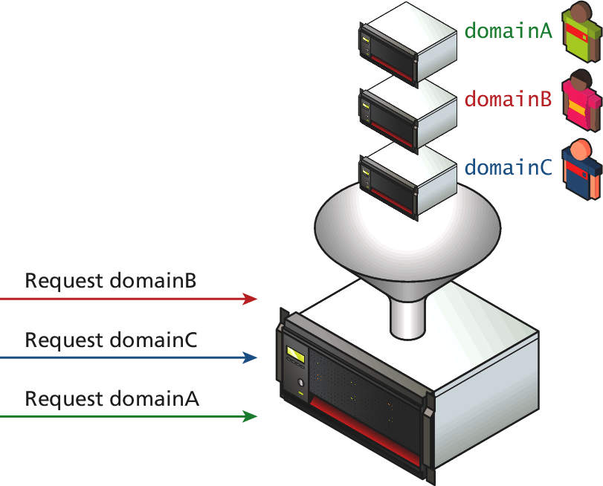
Virtualized Shared Hosting
Better, but still cost effective
Virtualized shared hosting is a variation on the shared hosting scheme, where instead of being given a username and a home directory on a shared server, you are given a virtual server, with root access

Slide 10
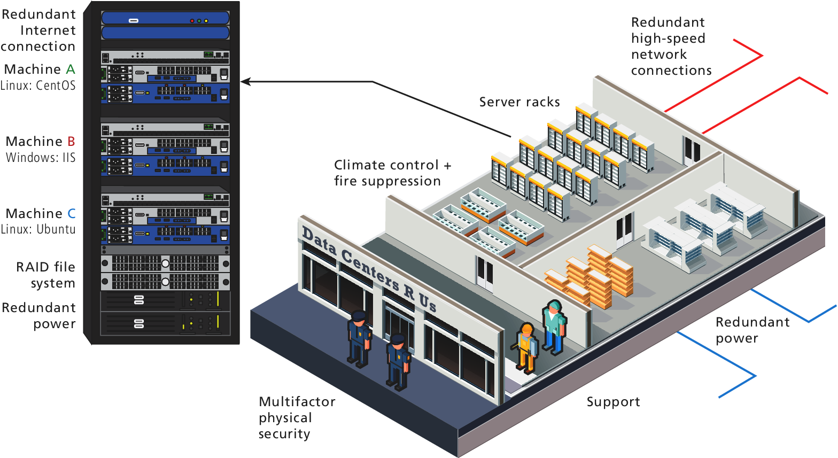
Dedicated Hosting
Almost your machine
Dedicated hosting is when a server is rented to you in its entirety inside the data center

Slide 11
Dedicated Hosting
Almost your machine
Data centers are normally located to take advantage of nearby Internet Exchange Points and benefit from redundant connections.
You are given a complete physical machine to control, removing the possible inequity that can arise when you share the CPU and RAM with other users.
The disadvantage of dedicated hosting is the lack of control over the hardware, and a restriction on accessing the hardware.

Slide 12
Collocated Hosting
Touch the machine
Collocated hosting is almost like dedicated hosting, except rather than rent a machine, you outright build, own, and manage the machine yourself.
The advantage of collocated hosting goes beyond a dedicated server with not only full control over the OS, software version, firewalls, and policies but also the physical machine.
The disadvantage of collocated systems is that you must control everything yourself, with little to no support from a third party and they are costly

Slide 13
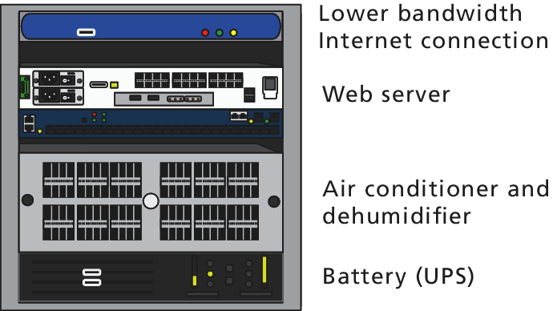
In House Hosting
Do everything yourself
Many companies do use a low-cost, in-house hosting environment for development, preproduction, and sandbox environments.
In practice, though, many small companies’ in-house data centers are just closets with an air conditioner, unsecured, and without any redundancies.

Slide 14
Cloud Hosting
Ignore the man behind the curtain
Cloud hosting is the newest buzzword in shared hosting services.
The advantages are
scalability, where more computing and data storage are needed and
The redundancy of a distributed solution
Unfortunately, many providers are cashing in on the latest buzzwords without the benefits.
At the end of the day a request for your website has to be answered by a physical machine with access to RAM, file system, and an OS.

Slide 15
Domain and Name Server Administration
Section 2 of 5

Slide 16
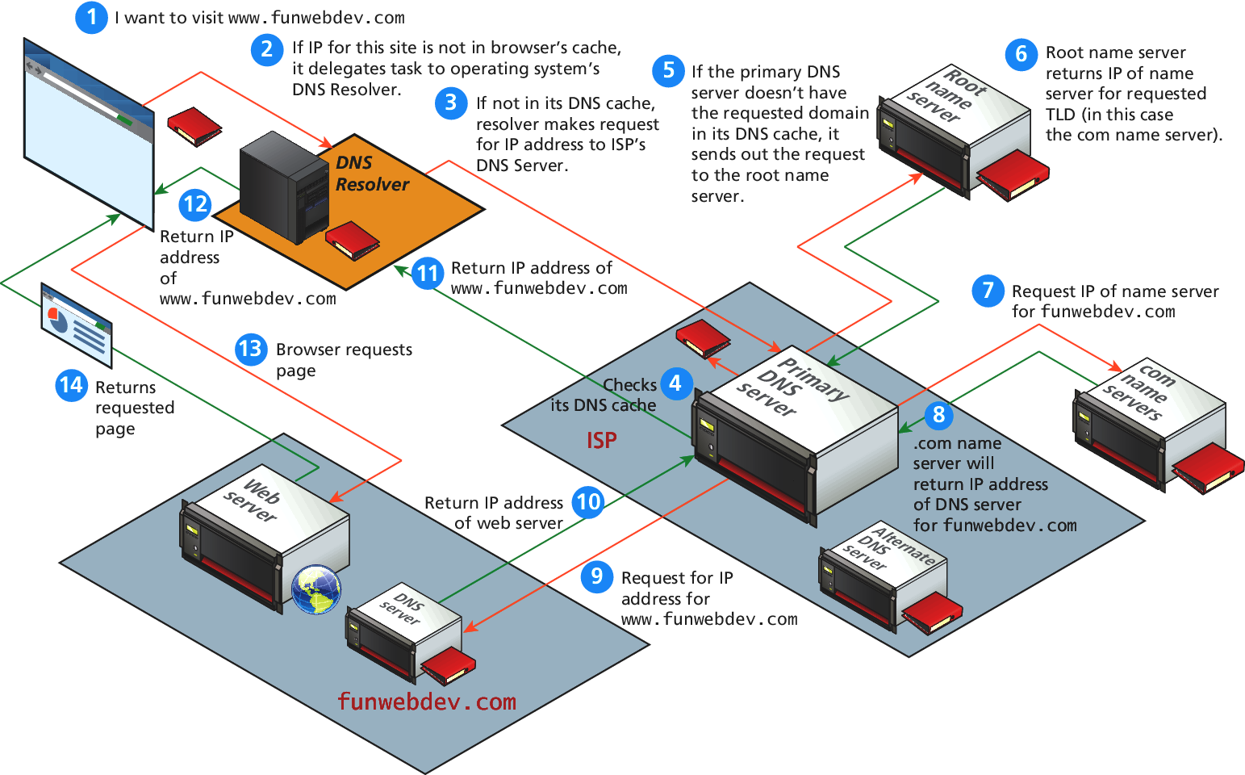
Domain Name System
Better than remembering IP addresses

Slide 17
Registering a Domain Name
Step one to your fortune
You only lease the right to use the name exclusively for a period, and must renew periodically.
Registrars are companies that register domain names, on your behalf (the registrant), under the oversight of ICANN.
Some popular registrars include GoDaddy, TuCows, and Network Solutions, where you can expect to pay from $10.00 per year per domain name.

Slide 18
Registering a Domain Name
WHOIS
The registrars must collect and maintain your information in a database of WHOIS records that includes three levels of contact (registrant, technical, and billing), who are often the same person.
Anyone can try and find out who owns a domain by running the WHOIS command and reading the output.

Slide 19
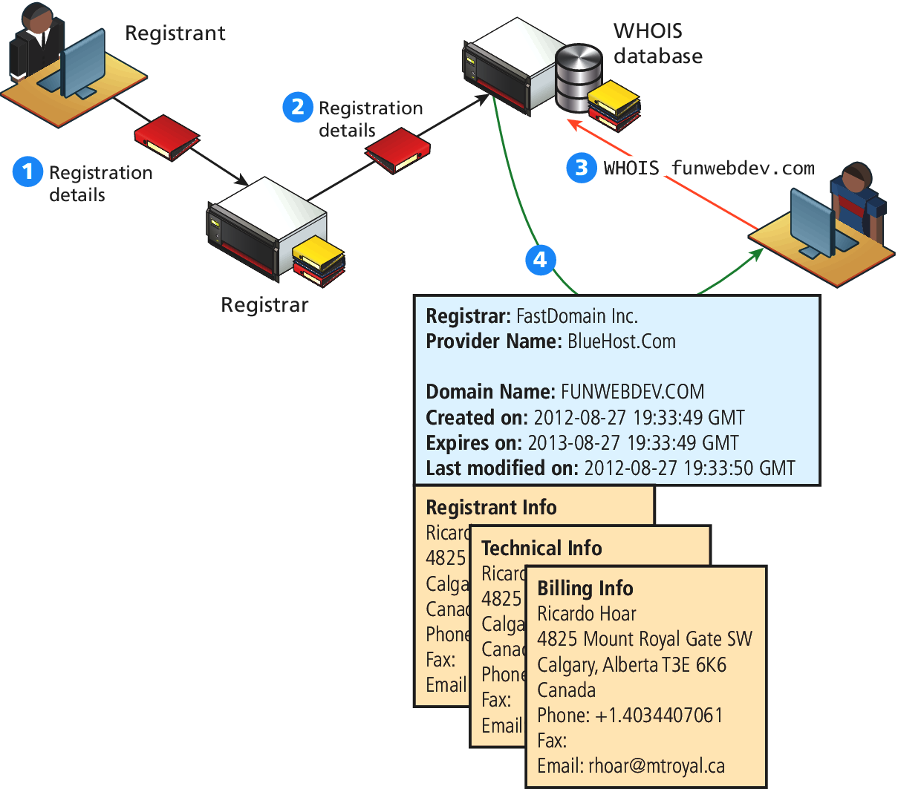
Whois
A Visualization

Slide 20
Whois
Private Visualization
Many registrars provide private registration services, which broker a deal with a private company as an intermediary to register the domain on your behalf.
The private registration company keeps your real contact information on their own servers because they must know who to contact if the need arises.
These private registrants will turn your information over to authorities upon request

Slide 21
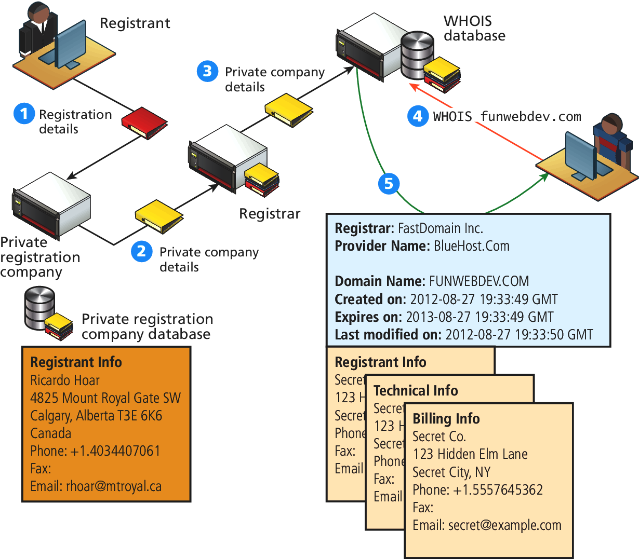
Whois
Private Visualization

Slide 22
Updating the Name Servers
Easy to use, a little tricky to update
The single most important thing you do with your registrar is control the name servers associated with the domain name.
Your web host will provide name servers which then have to get registered with the registrar you used when you leased the domain.
When you update your name server, the registrar, on your behalf, updates your name server records on the top-level domain (TLD) name servers

Slide 23
Checking Name Servers
Some little tricks
Updating records in DNS may require at least 48 hours to ensure that the changes have propagated throughout the system.
After updating your name servers with the registrar, it’s a good practice to “dig” on your TLD servers to confirm that the changes have been made.
Dig is a command that lets you ask a particular name server about records of a particular type for any domain.

Slide 24
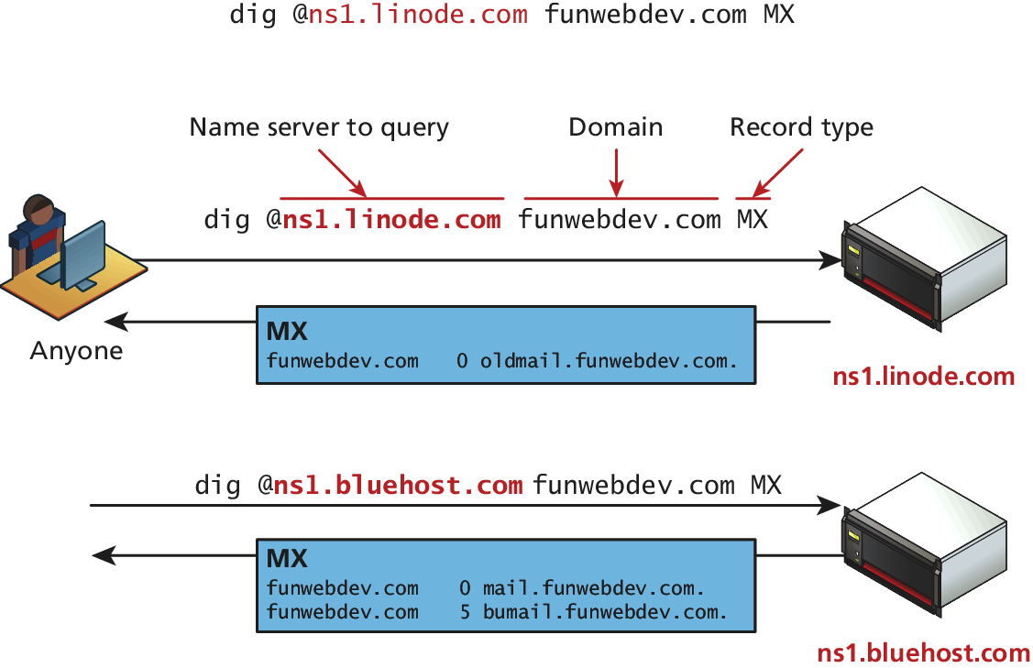
Checking Name Servers
Dig it

Slide 25
DNS Record Types
Host, Mail Server, Name Server, Alias, …
In practice, all of a domain’s records are stored in a single file called the DNS zone file.
There are six primary types of records
A/AAA,
CName,
MX,
NS,
SOA, and
TXT/SPF

Slide 26
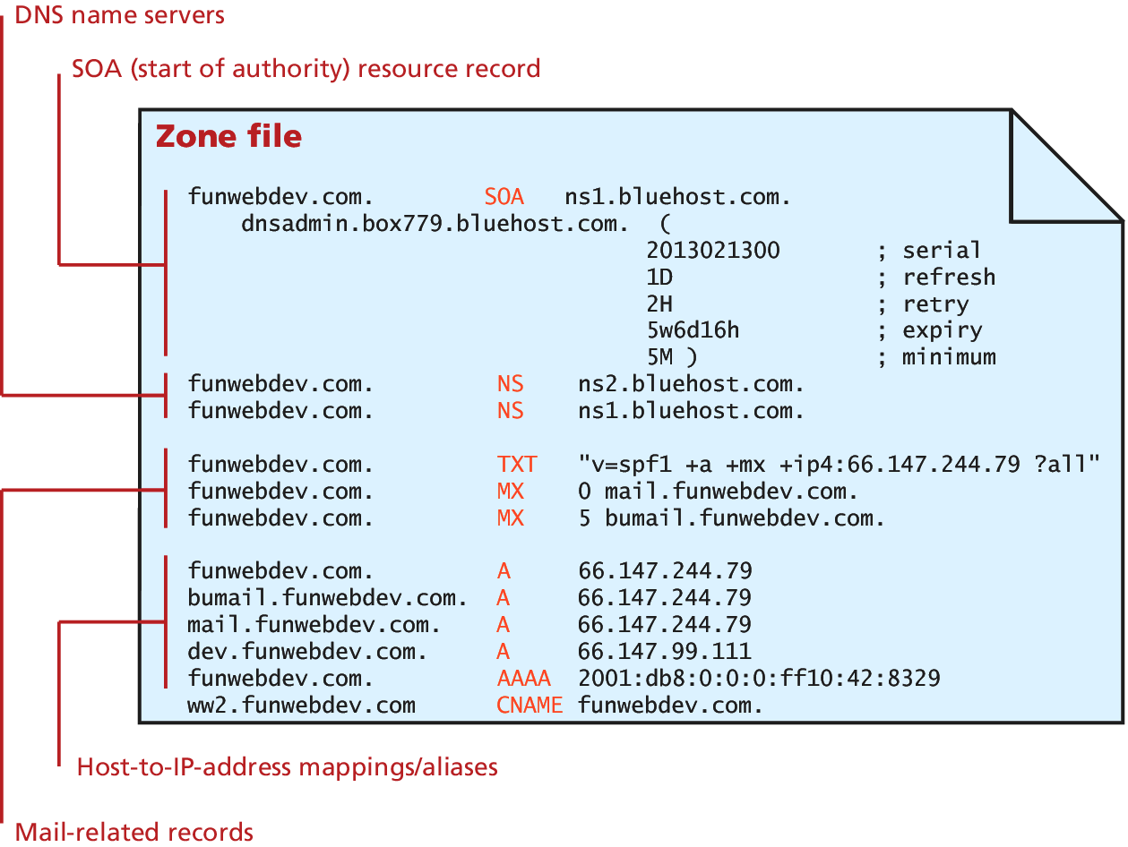
DNS Record Types
Zone file

Slide 27
DNS Record Types
A and AAAA Records
A records and AAAA records are identical except A records use IPv4 addresses and AAAA records use IPv6.
Both of them simply associate a hostname with an IP address.
These are the most common queries, performed whenever a user requests a domain through a browser.

Slide 28
DNS Record Types
CNAME Records
Canonical Name (CName) records is allow you to point multiple subdomains to an existing A record.
This allows you to update all your domains at once by changing the one A record. However, it doubles the number of queries required to get resolution for your domain, making A records the preferred technique.
It is sometimes called an alias.
The new alias
An A Record exists for this

Slide 29
DNS Record Types
CNAME Records
Canonical Name (CName) records is allow you to point multiple subdomains to an existing A record.
This allows you to update all your domains at once by changing the one A record. However, it doubles the number of queries required to get resolution
It is sometimes called an alias.
The new alias
An A Record exists for this

Slide 30
DNS Record Types
Mail Records
Mail Exchange (MX) records are the records that provide the location of the Simple Mail Transfer Protocol (SMTP) servers to receive email for this domain.
SMTP allows redundant mail servers for load distribution or backup purposes. To support that feature, MX records not only require an IP address but also a ranking.
When trying to deliver mail, the lowest numbered servers are tried first, and only if they are down, will the higher ones be used.
ranking

Slide 31
DNS Record Types
Authoritative Records
Name server (NS) records are the essential records that tell everyone what name servers to use for this domain. There can be (and should be) multiple name servers listed for redundancy.
Start of Authority (SOA) record contains information about how long this record is valid [called time to live (TTL)], together with a serial number that gets incremented with each update to help synchronize DNS

Slide 32
DNS Record Types
Start of Authority (SOA) record

Slide 33
DNS Record Types
Validation Records
TXT and Sender Policy Framework (SPF) records are used to reduce email spam by providing another mechanism to validate your mail servers for the domain.
SPF records appear as both SPF and TXT records.
The value is a string, enclosed in double quotes (" ") that starts with v=spf1 (the version) and uses space-separated selectors with modifiers to define which machines should be allowed to send email as this domain.

Slide 34
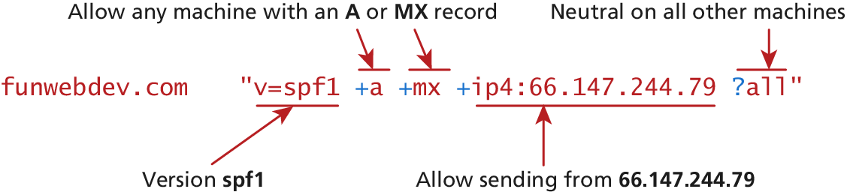
DNS Record Types
Validation Records

Slide 35
Reverse DNS
in-addr.apra
Reverse DNS is the reverse process, whereby you get a domain name from an IP address
A pointer (PTR) record is created with the IP address prepended in reverse order to the domain in-addr.arpa
66.147.244.79 becomes the PTR entry
funwebdev.com PTR 79.244.147.66.in-addr.apra
Now, when a mail server wants to determine if a received email is spam or not, they recreate the in-addr.apra hostname from the IP in the email and resolve it like any other DNS request based on the domain it claims to be from.

Slide 36
Linux and Apache Configuration
Section 3 of 5

Slide 37
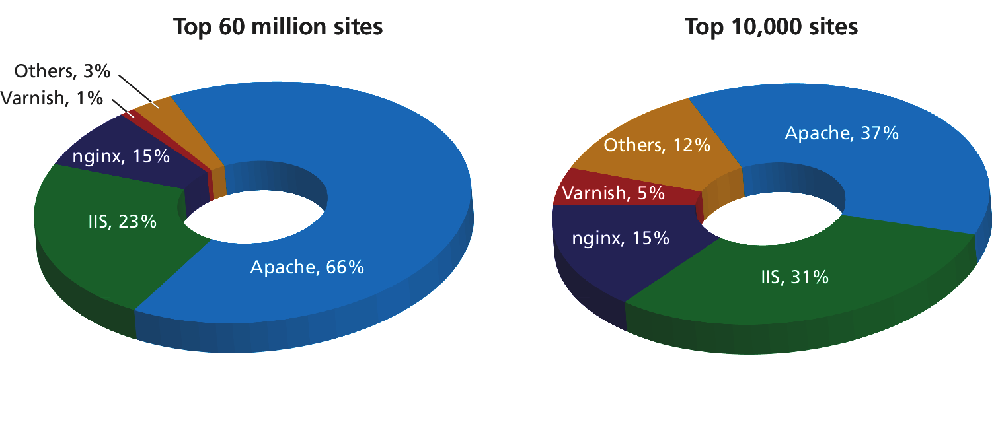
Apache
The world’s most popular webserver
Web server software like Apache is responsible for handling HTTP requests on your server.

Slide 38
Apache
Configuration
Apache can be configured through two key locations
When Apache is started or restarted, it parses the root configuration file, which is normally writable by only root users (stored in /etc/httpd.conf, or somewhere similar).
directory-level configuration files are permitted which can change the behavior of the server without having to restart Apache. The files are normally named .htaccess (hypertext access), and they can reside inside any of the public folders served by Apache.

Slide 39
Daemons
Apache runs all the time
A daemon is software that runs forever in the background of an operating system and normally provides one simple service. Daemons on Linux include sshd, httpd, mysqld, as well as many others.
To start, stop and restart the Apache daemon from the command line in Linux, the root user can enter these commands:
/etc/init.d/httpd start
/etc/init.d/httpd stop
/etc/init.d/httpd restart

Slide 40
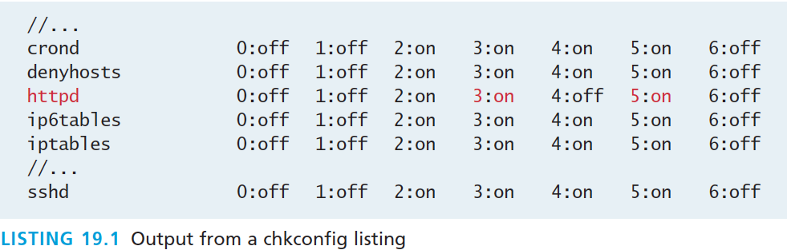
Managing Daemons
Make sure it starts on boot
You can check to see what is running on boot by typing:
chkconfig –list
The output will show the daemon name and a run level 0–6
httpd is apache

Slide 41
Run Levels
Linux Runlevels
Linux defines multiple “levels” in which the operating system can run, which correspond to different levels of service. Although the details vary between distributions they are generally considered to be:
0. Halt (shut down)
1. Single-user mode
2. Multiuser mode, no networking
3. Multiuser mode with networking
4. Unused
5. Multiuser mode with networking and GUI (Windows)
6. Reboot

Slide 42
Run Levels
Linux Runlevels
In practice, we normally consider only two run levels,
run level 3 (headless production machine)
run level 5 (development machine with GUI)
Since many services are needed on all levels, you can easily turn on the Apache daemon for levels 2, 3, 4, and 5 at boot by typing the command:
chkconfig httpd on
Similarly, to turn off an FTP service one can type the command:
chkconfig ftpd off

Slide 43
Applying configuration changes
Restarting Apache
Every time you make a change to a configuration file, you must restart the daemon in order for the changes to take effect.
/etc/init.d/httpd restart
However, if there’s an error in your configuration file, the server will stop, and then not restart!
Always check your configuration before restarting using:
/etc/init.d/httpd configtest
This command will literally output Syntax OK

Slide 44
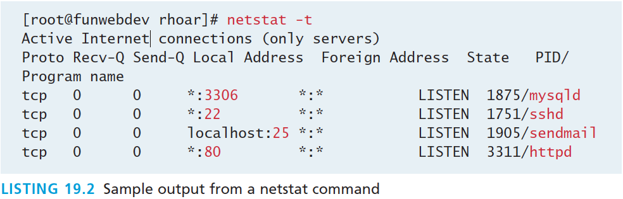
Connection Management
And observation
The netstat -t command shows which daemons are running and listening to network ports
In addition to being aware of which services are listening in general, you can manage numerous configuration options related to the number and type of connections for Apache.

Slide 45
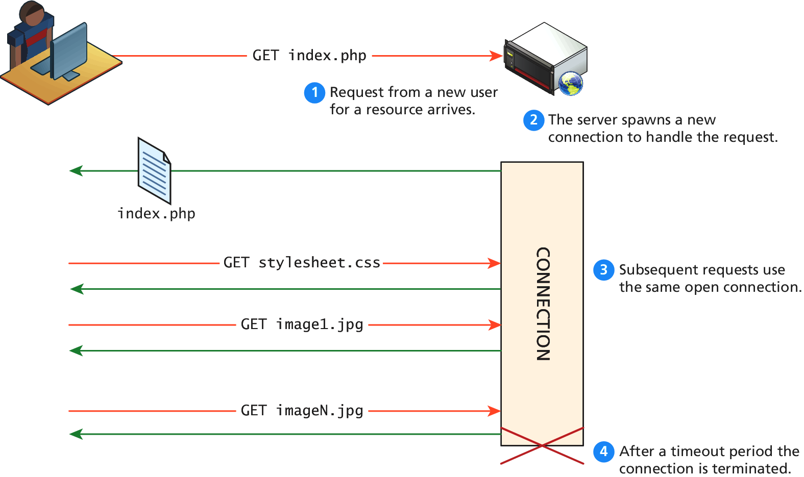
Connection Management
Fine tuning your server

Slide 46
Connection Management
Fine tuning your server
These options permit a detailed tuning of your server for various loads using configuration directives stored in the Apache configuration files.
Timeout defines how long, in seconds, the server waits for receipts from the client (remember, delivery is guaranteed).
KeepAlive is a Boolean value that tells Apache whether or not to allow more than one request per connection.
MaxKeepAliveRequests sets how many requests to allow per persistent connection.
KeepAliveTimeout tells the server how long to keep a connection alive between requests.

Slide 47
Connection Management
Fine tuning your server
It’s a balancing act with no single solution.
Open connections take resources that could go toward serving new requests
Allowing multiple requests from the same client to be served by the same connection saves resources by not having to spawn a new connection for each request
Additional directives like StartServers, MaxClients, MaxRequestsPerChild, and ThreadsPerChild provide additional control over the number of threads, processes, and connections per thread.

Slide 48
Ports
Listen
In Apache terminology, the server is said to listen for requests on specific ports.
Recall that the various TCP/IP protocols are assigned port numbers. For instance,
the FTP protocol is assigned port 21, while
the HTTP protocol is assigned port 80
In Apache, the Listen directive tells the server which IP/Port combinations to listen on.
Listen 80
If you want to have websites on different ports, you can use multiple Listen directives.

Slide 49
Data Compression
Saving bandwidth
The HTTP headers allow client and server to know whether compression can be used.
Deciding whether to compress data may at first glance seem like an easy decision but some files like .jpg files are already compressed, and re-compressing them will use up CPU time needlessly.
The Apache directive below adds compression (when agreed to with the client) to items of type text/html
AddOutputFilterByType DEFLATE text/html

Slide 50
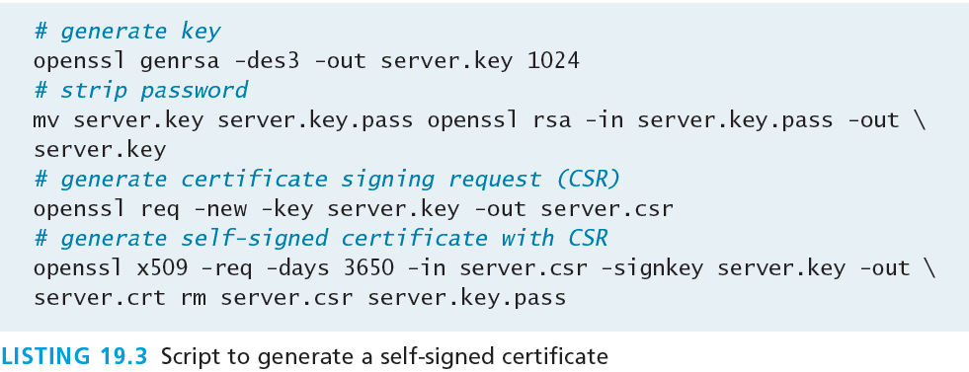
Encryption and SSL
Remember the cryptography from Chapter 16?
All encrypted traffic requires the use of an X.509 public key certificate, which contains cryptographic keys as well as information about the site (identity).
creating your own certificates is very straightforward, as illustrated by the shell script below

Slide 51
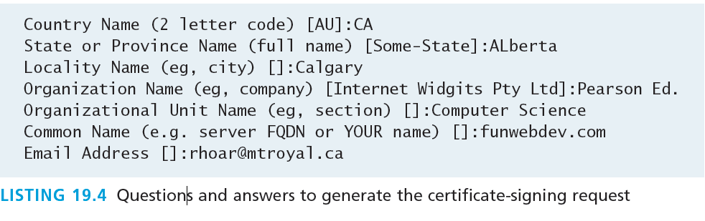
Encryption and SSL
Certificate Signing
Self-signed certificates work; it’s just that the user will have to approve an exception to the strict rules configured by most browsers.

Slide 52
Encryption and SSL
Apache configuration details
Signed certificates generally require uploading the certificate signing request generated in Listing 19.3 to get a server.crt file returned by email.
However you sign, you will have two files that are used by Apache
SSLCertificateFile /path/to/this/server.crt
SSLCertificateKeyFile /path/to/this/server.key
Remember, you must also Listen on port 443 in order to get Apache to work correctly using secure connections.

Slide 53
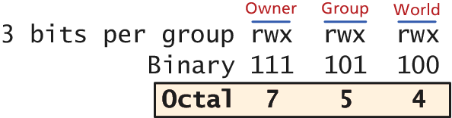
File Ownership and Permissions
A review for many
Apache runs as its own user (sometimes called Apache, WWW, or HTTP depending on configuration). In to serve files, Apache needs permission to access them.
Typically, newly created PHP files are granted 644 octal permissions so that the owner can read and write, while the group and world can read. This means that no matter what username Apache is running under, it can read the file.

Slide 54
File Ownership and Permissions
Security risk
A security risk can arise on a shared server if you set a file to world writable.
This means users on the system who can get access to that file can write their own content to it, circumventing any authentication you have in place.
Many shared hosts have been “hacked” by a user simply overwriting the index.php file with a file of their choosing.
This is why you should never set permissions to 777, especially on a simple shared host.

Slide 55
Apache Request and Response Management
Section 4 of 5

Slide 56
Managing Multiple Domains
On One Webserver
A web server can easily be made to serve multiple sites from the same machine.
Having multiple sites running on a single server can be a great advantage to companies or individuals hosting multiple small websites.
A VirtualHost is an Apache configuration directive that associates a particular combination of server name and port to a folder on the server.

Slide 57
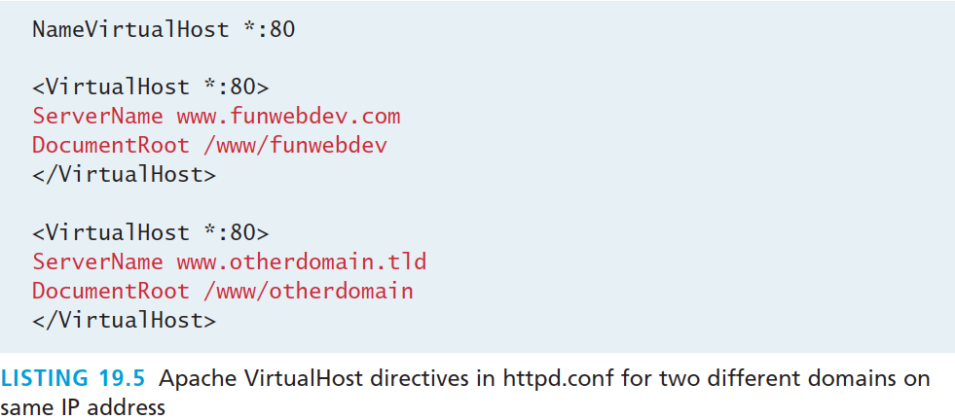
Managing Multiple Domains
VirtualHost Directive
Each distinct VirtualHost must specify
which IP and port to listen on
what file system location to use as the root for that domain.
NameVirtualHost allows you to use domain names instead of IP addresses. This means many domains on 1 IP address!

Slide 58
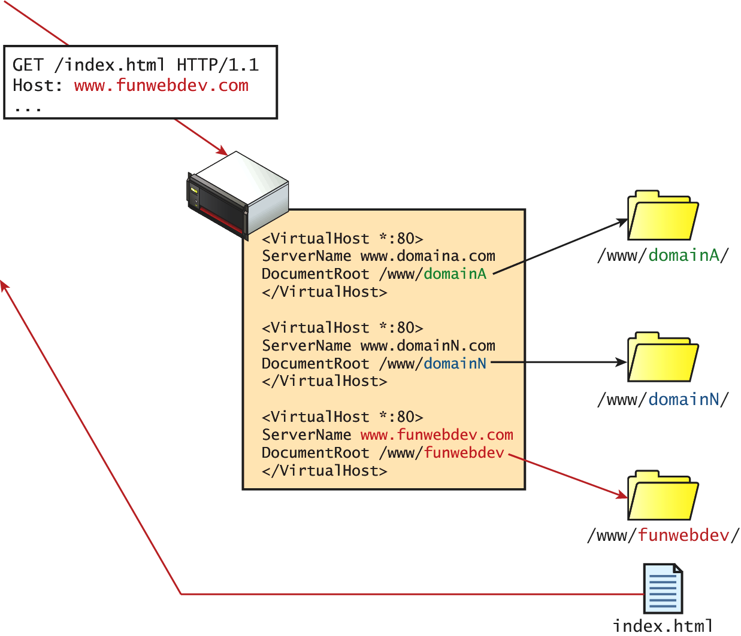
Managing Multiple Domains
VirtualHost Visualization

Slide 59
Handling Directory Requests
The index files
In practice, users normally request a domain’s homepage URL without specifying what file they want.
There are times when clients are requesting a folder path, rather than a file path. The domain root is a special case of the folder question, where the folder being requested is the root folder for that domain.
However a folder is requested, the server must be able to determine what to serve in response

Slide 60
Handling Directory Requests
What to serve?
The server could choose
a file to serve
display the directory contents
return an error code
You can control this by adding DirectoryIndex and Options directives to the Apache configuration file.

Slide 61
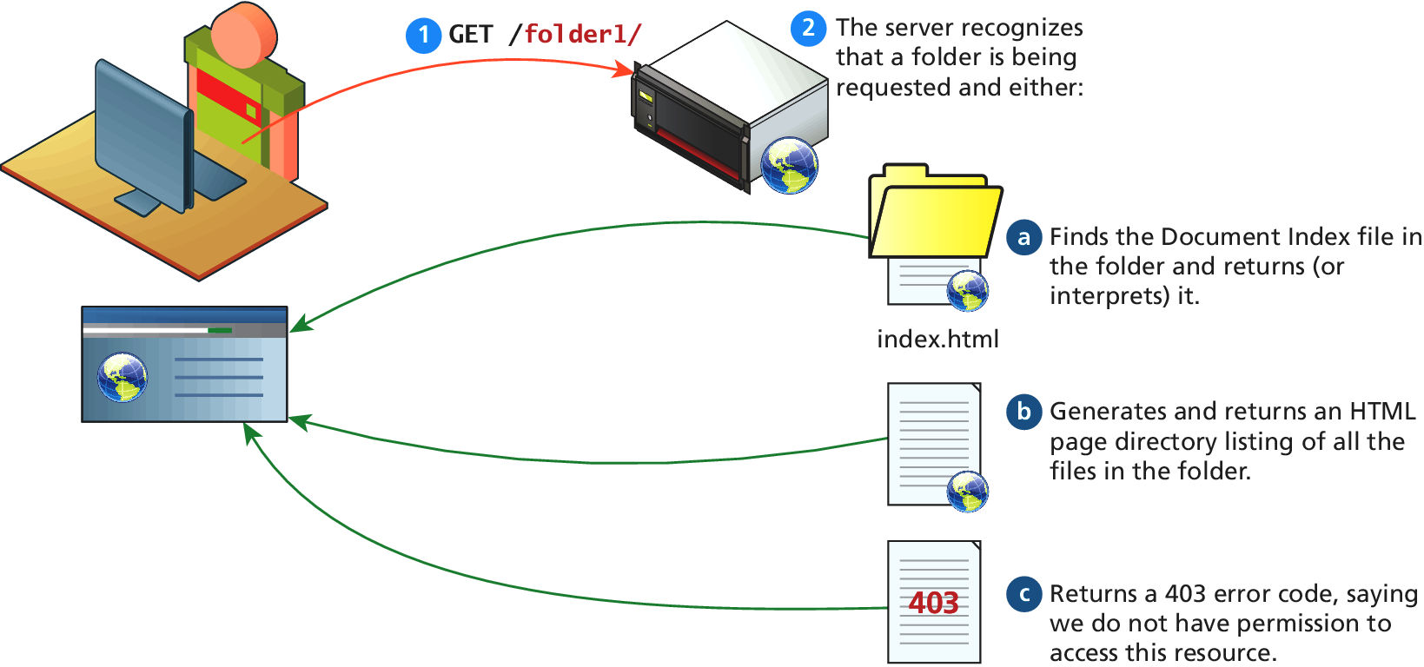
Handling Directory Requests
What to serve?

Slide 62
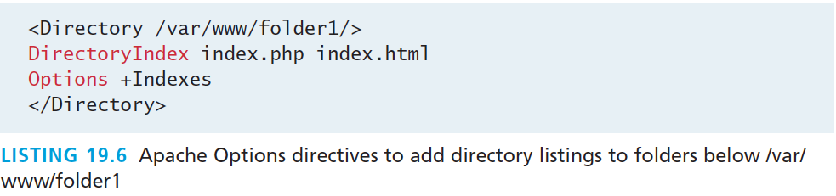
Handling Directory Requests
How did it come to pass that we use index.php
The DirectoryIndex directive configures the server to respond with a particular file
in this case index.php, and if it’s not present, index.html
The Options directives can be used to tell the server to build a clickable index page from the content of the folder in response to a folder request.

Slide 63
Responding to File Requests
Static and Dynamic
The most basic operation a web server performs is responding to an HTTP request for a static file.
Having mapped the request to a particular file location using the connection management options above, the server sends the requested file, along with the relevant HTTP headers to signify that this request was successfully responded to.
dynamic file requests must be interpreted at request time rather than sent back directly as responses

Slide 64
Responding to File Requests
Which files get interpreted
A web server associates certain file extensions with MIME types that need to be interpreted. When you install Apache for PHP, this is done automatically, but can be overridden through directives.
If you wanted files with PHP as well as HTML extensions to be interpreted (so you could include PHP code inside them), you would add the directive below, which uses the PHP MIME types:
AddHandler application/x-httpd-php .php
AddHandler application/x-httpd-php .html

Slide 65
URL Redirection
We’ve come across this before…
In Apache, there are two major classes of redirection,
public redirection and
internal redirection (also called URL rewriting).

Slide 66
Public Redirection
In public redirection, you may have a URL that no longer exists or has been moved.
If users have bookmarks to old URLs, they will get 404 error codes when requesting them
It is a better practice to inform users that their old pages have moved, using a HTTP 302 header
In Apache such URL redirection is easily achieved, using Apache directives

Slide 67
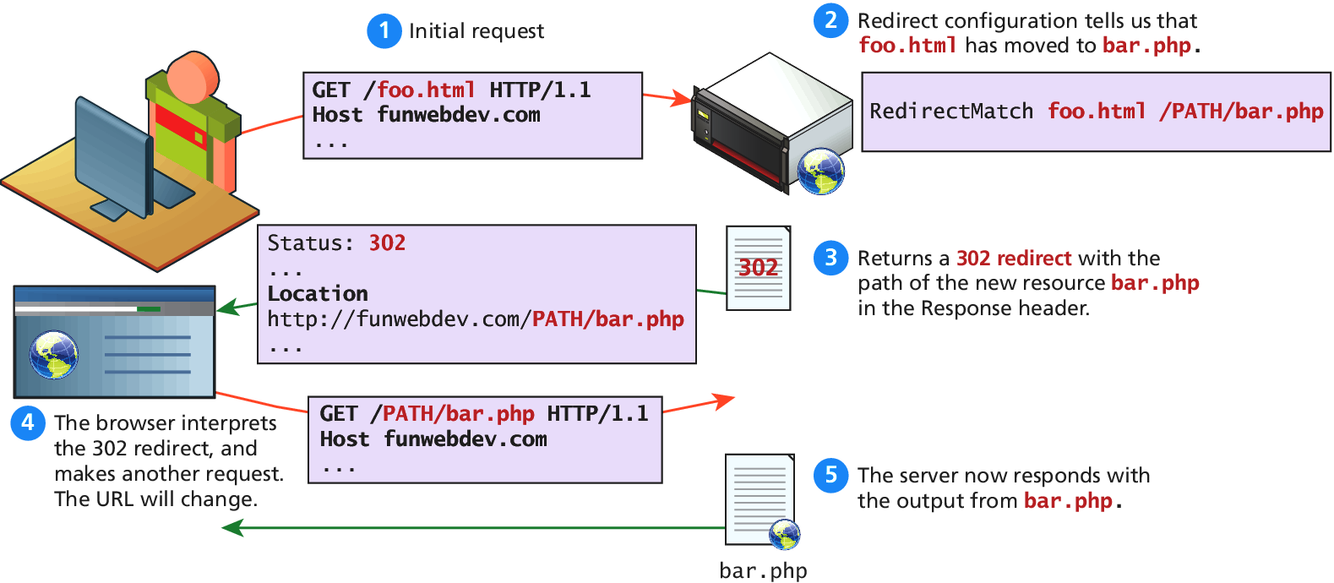
Public Redirection
Two requests required, and everybody knows

Slide 68
Public Redirection
There are Apache Directives
Using RedirectMatch foo.html is publically redirected to bar.php
RedirectMatch /foo.html /FULLPATH/bar.php
Alternatively the RewriteEngine module can be invoked to create an equivalent rule:
RewriteEngine on RewriteRule ^/foo\.html$ /FULLPATH/bar.php [R]

Slide 69
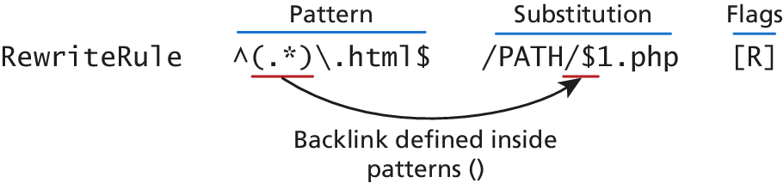
Public Redirection
The RedirectRule Directive
RewriteRule directive consists of three parts:
the pattern to match,
the substitution, and
Flags
Use can use regular expression syntax to capture back-references for use in the substitution.

Slide 70
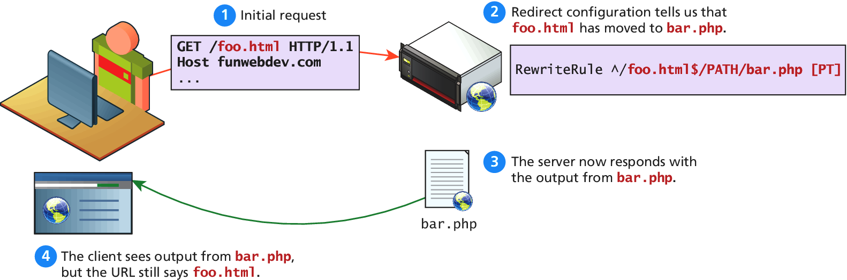
Internal Redirection
One fewer requests

Slide 71
Internal Redirection
One fewer requests
To enable such a case, simply modify the rewrite rule’s flag from redirect (R) to pass-through (PT), which indicates to pass-through internally and not redirect.
RewriteEngine on
RewriteRule ^/foo\.html$ /FULLPATH/bar.php [PT]

Slide 72
Conditional ReWriting
Internal or Public
RewriteCondition combined with the RewriteRule can be thought of as a conditional statement.
If more than one rewrite condition is specified, they must all match for the rewrite to execute.
The RewriteCond consists of three parts,
a test string
and a conditional pattern.
Sometimes flags, is also used.

Slide 73

Conditional ReWriting
Internal or Public
The example below allows us to redirect if the request is coming from an IP that begins with 192.168.

Slide 74
Conditional ReWriting
An advanced example
To prevent hot-linking of your image files consider a conditional redirect that only allows images to be returned if the HTTP_REFERER header is from our domain:
RewriteEngine On RewriteCond %{HTTP_REFERER} !^http://(www\.)? funwebdev\.com/.*$ [NC] RewriteRule \.(jpg|gif|bmp|png)$ - [F]
To return a small static image for all invalid requests use the following directives:
RewriteEngine On RewriteCond %{HTTP_REFERER} !^http://(www\.)?funwebdev\.com/.*$ [NC] RewriteRule \.(jpg|gif|bmp|png)$ http://funwebdev.com/stopIt.png
NC – Case insensitive
F - Forbidden

Slide 75
Managing Access with .htaccess
Should have done his a long time ago (maybe you did)
.htaccess files are the directory-level configuration files used by Apache to store directives to apply to this particular folder.
While most websites will track and manage users using a database with PHP authentication scripts, a simpler mechanism exists when you need to quickly password protect a file or folder.

Slide 76
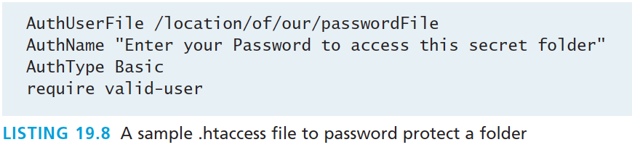
Managing Access with .htaccess
Add a file to the folder and point to a password file
To create a new password file, you would type the following command:
htpasswd –c passwordFile ricardo
This will create a file named passwordFile and prompt you for a password for the user ricardo (I chose password).
.htaccess, can now point to that password file

Slide 77
Server Caching
Another Cache
Server caching is distinct from:
HTTP caching built into the HTTP protocol
the caching technique using PHP described in Chapter 13
Apache caching supplements provides another caching mechanism (in the form of a module, mod_cache) that allows you to save copies of HTTP responses on the server so that the PHP script that created them won’t have to run again.

Slide 78
Server Caching
Another Cache
There are two types of server cache,
a memory cache
a disk cache.
The memory cache is faster, but of course the server RAM is limited. The disk cache is slower, but can support more data.
Caching is based on URLs so that every cached page is associated with a particular URL.

Slide 79
Server Caching
Directives – in brief
Some important directives related to the mod_cache module are:
CacheEnable turns caching on. You include whether to use disk or memory caching and the location. To cache all requests for a subdomain archive.funwebdev.com, you would type the directive. CacheEnable disk archive.funwebdev.com
CacheRoot defines the folder on your server to store all the cached resources. You might save cached files in a high-speed, solid-state mounted disk, for instance, as follows: CacheRoot /fastdisk/cache/
CacheDefaultExpire determines how long in seconds something in cache is stored before the cached copy expires.

Slide 80
Web Monitoring and Analytics
Section 5 of 5

Slide 81
Monitoring
Internal and External
Internal monitoring reads the outputted logs of all the daemons to look for potential issues.
External monitoring is installed off of the server and checks to see that connections to required services are open.

Slide 82
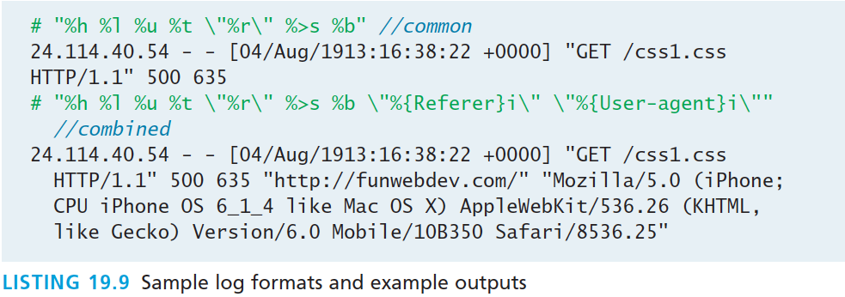
Internal Monitoring
Apache Logging
Logging relates closely to Apache, since Apache directives determine what information goes into the WWW logs.
You can define a log file using the directive CustomLog:
CustomLog /var/log/funwebdev/access_log nickname

Slide 83
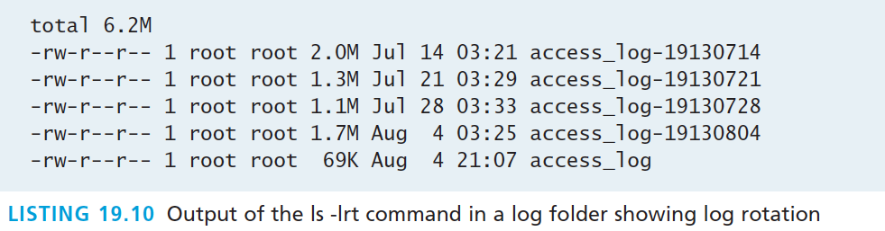
Internal Monitoring
Log rotation
If no maintenance of your log files is ever done, then the logs would keep accumulating and the file would grow in size until eventually it would start to impact performance or even use up all the space on the system.
logrotate is the daemon running on most systems by default to handle this task.

Slide 84
External Monitoring
Test the network
Monitoring software like Nagios can check for uptime and immediately notify the administrator if a service goes down.
Much like internal logs, external monitoring logs can be used to generate uptime reports and other visual summaries of your server.

Slide 85
Internal Analytics
Build on your logs
Analysis packages such as AWStats and Webalizer allow you to easily set up periodic analysis of the log files to create bar graphs; pie charts; and lists of top users, browsers, countries, and more

Slide 86
Third-Party Analytics
Put in a little piece of JavaScript
Third-party systems like Google Analytics provide much of the same data, but rather than collect it from your logs, they embed a small piece of JavaScript into each page of your site.
These statistics can be more robust than the free tools, but require every visit to the site to execute another script, slowing performance.

Slide 87
Third-Party Support Tools
Let us help
These tools provide information about
Indexed terms and weights
Indexing errors that were encountered
Search ranking and traffic
Frequency of being crawled
Response time during the crawls
To sign up for these tools, go to www.google.com/webmasters/tools/ and http://www.bing.com/toolbox/webmaster.

Slide 88
Third-Party Support Tools
Screenshot of Google’s Webmaster Tools

Slide 89
What You’ve Learned
1
2
Web Server Hosting Options
Domain and Name Server Administration
3
4
Linux and Apache Configuration
Apache Request/Response
5
Web Monitoring and Analytics

